Slide 1
Introduction To DBMS

Slide 2
Agenda
DBMS
Need for RDBMS
Schema
Query Types
Keys in DBMS
Query and Clauses
Conditions in Query
Aggregate Functions
Joins

Slide 3
What is DBMS ?
A Database Management System (DBMS) is a software package designed to store and manage databases.
Examples of database:
MYSQL,
Oracle,
Maria DB, etc

Slide 4
Types of DBMS
Hierarchical
Network
Relational
Object Oriented

Slide 5
Types of DBMS
Hierarchical
Also called Hierarchical Database Management System (HDBMS)
Easy to access at the top level
Difficult to access in the bottom levels.
This type of storage is called linear storage.
Vehicles
Road
Water
Air
Car
Boat
Drone

Slide 6
Types of DBMS
2. Network
Also called Network Database Management System (NBMS)
Modified version of the Hierarchical model.
Uses pointers to point different tables/entities in the background.
Very difficult to use this kind of database.
Restaurant
Cashier
Server
Cook
Money
Food

Slide 7
Types of DBMS
3. Relational Database
Also called Relational Database Management System (RDBMS)
Columns are called Column or fields or attributes.
Rows are called Records or Tuples.
Number of rows is called cardinality of the table.
S.No | Mobile Number | City
1 | 11111 11111 | Mumbai
2 | 22222 22222 | Delhi
3 | 33333 33333 | Jaipur

Slide 8
Types of DBMS
4. Object Oriented Database
Also called Object Oriented Database Management System (OORDBMS)
Use of Object oriented concepts in database is called Object Oriented RDBMS
Uses concepts of Objects, Classes, Principles of OOP, and many more

Slide 9
RDBMS
The data which is organized in a grid (table) like structure forming relation between rows and columns is called relational database.
Example:
Relation between Employee and salary in the below table
Relational Database Management System (RDBMS) is an modified version of DBMS.
Similarly we can relate two or more tables.
Emp_Id | Emp_Name | Salary
12 | Ram | 3,00,000
14 | John | 4,50,000

Slide 10
Problems with File System
Data Redundancy: Same data in multiple places
Data Inconsistency: Same data in different format in different places
Data Integrity problems: overall completeness of data
Difficulty in accessing data
Atomicity of updates: perform all set of operations or none
Concurrent access by multiple users

Slide 11
Advantages of RDBMS
Data Consistency
Reduced Data Redundancy
Data Integrity
Atomicity
Concurrent access by maintaining log files

Slide 12
Schema Definition
The structural view that shows the entire logical representation of the database.

Slide 13
Schema Architecture
The schema Architecture is divided into Physical and Logical.
Physical Database Schema: This schema handles how to store data in secondary storage.
Logical Database Schema: This handles logical constraints on the data being stored.

Slide 14
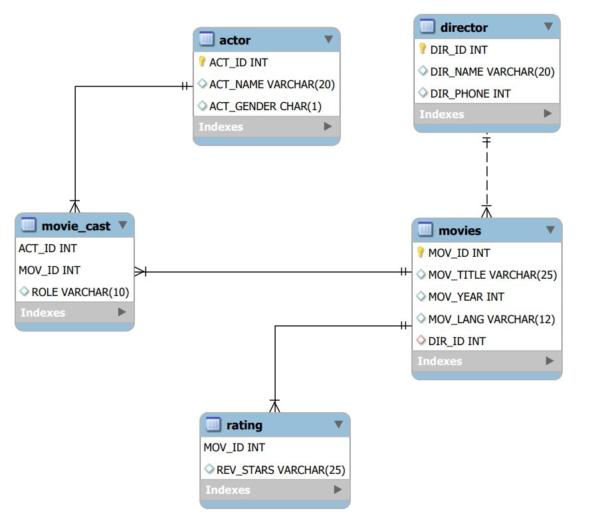
Schema Example

Slide 15
Types of SQL commands
SQL commands are classified into subcategories. They are:
DDL - Data definition language
DML -Data manipulation language
DCL - Data control language
TCL - Transaction control language

Slide 16
DDL Definition
Data definition language (DDL) commands are used to define database structure.
We have create, alter, rename, truncate, drop commands in DDL.

Slide 17
DDL Syntax
Syntax:
create database database_name; // create database
create table table_name (attribute_1 data_type, attribute_2 data_type,.....); // create table
alter table table_name add column column_name data_type; // add column
alter table table_name modify column column_name data_type; // modify column data_type only
alter table table_name rename to new_table_name // rename table
alter table table_name rename column column_name to new_column_name // rename column
alter table table_name drop column column_name ; // drop column
rename table table_name to new_table_name // rename table
truncate table table_name ; // truncate table
drop table table_name ; // drop table
drop database table_name ; // drop database

Slide 18
DDL Example
Create
create database employee_DBMS; // create database
create table emp_details(id int , name varchar(50), department varchar(50), salary int);
Alter
alter table emp_details add column Address varchar(50); // add column
alter table emp_details modify column Address varchar(100); // modify column
alter table emp_details drop column Address ; // drop column
alter table emp_details rename column name to emp_name// rename column
alter table emp_details rename to employee_details// rename table
Rename
rename table employee_details to emp_details // rename table
Truncate
truncate table emp_details; // truncate table(deletes table data only)
Drop
drop table emp_details; // drop table
drop database employee_DBMS; // drop database

Slide 19
DML Definition
Data manipulation language are commands used to manipulate data in table.
select, insert, update, delete

Slide 20
DML Syntax
Syntax:
Insert
insert into table_name values (val_1, val_2); // comma separated insertion
Or
insert into table_name (attribute_2, attribute_1) values (value_2, value_1);
Select
select * from table_name
select column_name from table_name
Update
update table_name set attribute = value2 where attribute =value1;
Delete
delete from table_name where attribute = value;

Slide 21
DML Example
Example:
Insert
insert into emp_details values (1,"Aman","IT ", 100000); // comma separated insertion
Or
insert into emp_details (id,name,department,salary) values (7,"ganga","IT",125000);
Select
select * from emp_details ;
select name from emp_details ;
Update.
update emp_details set name = "Ranbir" where id =3;
Delete
delete from emp_details where Id = 8;

Slide 22
DCL Definition
Data control language,i.e, commands which controls the data access in database.
Revoke, Grant

Slide 23
DCL Syntax
Syntax
grant privilege_name/s on object to user_account;
revoke privilege_name/s on object from user_account;
privilege_name/s: we specify the required privileges. The various privileges are:
Select, insert, delete, create, alter, update, drop, index, execute, all
Object:
database_name.* All tables in database
database_name.table_name specific table in a database
*.* All databases and all tables in them.
user_account:
username@hostname

Slide 24
DCL Example
//all permissions to all databases
grant all privileges on *.* to sam@localhost;
// select permission to employee database
grant select on employee_DBMS.* to sam@localhost;
// specific access privileges to table column/s for a user
grant select(id), insert(id, name) on employee_DBMS.emp_details to sam@localhost;
// revoke select permission on table emp.details
revoke select on emp.details to sam@localhost;
//revoking more than one privilege on table emp.details
revoke select,insert,update,delete on emp.details to sam@localhost;

Slide 25
Keys and its types
Keys are used to find a row in database and also helps in identifying and establishing relationships between/among tables.
Types of keys
Primary Key
Super Key
Candidate Key
Foreign Key

Slide 26
Primary Key
Primary Key is a column in a table which uniquely identifies each tuple/row/record in a table.
It is unique and not null.
There can be only one primary key in a table. However , there can be multiple possible Primary Keys.
A Primary Key is selected from the possible Primary key based on the requirements.

Slide 27
Primary Key example
In the below example, Student Id, Student Aadhaar no. are best suited as Primary Key.
We have selected Student Id as a Primary Key.
Student
Student Id
Student Name
Student Marks
Student Aadhaar No
Primary Key

Slide 28
Super Key
It is a set of attributes that uniquely identify a row.
Super set of Candidate Key
Super Key can also contains attributes which do not play any role in identifying the dataset.

Slide 29
Super Key example
In the below example we can identify unique rows with the help of Id.
We can identify a row with the help of (Id, name) or (Id, marks). But, we cannot have name and marks as Super Keys.
Student
Student Id
Student name
Student marks
Student Aadhaar no.
Super Keys = (Student Id), (Student Id, Student name)
(Student Id, Student marks), (Adhaar no)… etc

Slide 30
Candidate Key
Candidate Key is a subset of Super Key.
It is a set of attributes that uniquely identify row (tuple) in a table.
Attributes that can become a Primary Key are considered as Candidate Key.
All Candidate Keys are Super Keys by default.

Slide 31
Candidate Key example
In the below example, Id is selected as Primary Key.
Student’s Aadhaar no can be a possible Primary Key and hence it is a Candidate Key.
Student
Student Id
Student name
Student marks
Student Aadhaar no.
Primary Key
Candidate Key

Slide 32
Foreign Key
It maintains referential integrity, ie , it provides a link among data of two tables.
It points to Primary Key of other table.

Slide 33
Foreign Key example
In the below example, for table student, student Id is primary Key and student address Id is Foreign Key.
For table address, student address Id is Primary Key.
Student
Student Id
Student name
Student marks
Student Aadhaar no.
Student address Id
Address
Student address Id
City
State
Primary Key
Foreign Key

Slide 34
Foreign Key query
create table Address(
Student_Address_Id int primary key,
city varchar(50),
state varchar(50)
);
CREATE TABLE Student (
Student_Id int primary key,
Student_Name varchar(50),
Student_Marks float,
Student_Aadhaar_No bigint,
Student_Address_Id int,
FOREIGN KEY (Student_Address_Id) REFERENCES Address(Student_Address_Id)
);
DO NOT WRITE ANYTHING
HERE. LEAVE THIS SPACE FOR
WEBCAM

Slide 35
Basic Query structure
Select col_name1,col_name2.. from table_name where…..
NOTE : The Clauses, Conditions, Aggregate functions are case insensitive.

Slide 36
Group By Clause
Used to group unique tuples based on attribute.
Group by Clause will mostly be executed with aggregate functions(count, sum, avg, max, min).
Syntax
SELECT col_name(s) FROM table_Name WHERE condition GROUP BY col_name(s);
Example:
select state,count(city) from address group by state;

Slide 37
Having Clause with example
We cannot use where keyword with Aggregate functions. Hence we use having keyword
Having Clause will always come after group by Clause;
Syntax
SELECT col_name(s) FROM table_Name GROUP BY col_name(s) having condition;
Example:
select state,count(city) from address group by state having count(city)>1;
Notes:
Please explain why we cannot use where keyword with aggregate functions

Slide 38
Order by Clause with example
Order all attribute values in ascending or descending order.
Syntax
SELECT col_name(s) FROM table_Name WHERE ORDER BY col_name ASC/DESC;
Example:
select Student_Name ,Student_Marks from Student order by Student_Marks asc;
select Student_Name ,Student_Marks from Student order by Student_Marks ;

Slide 39
AND Condition
It displays records if the Conditions which are separated by AND is/are TRUE.
Syntax
SELECT col_name(s) FROM table_Name WHERE condition1 AND condition2 ...;
Example:
select Student_Name,Student_Marks from Student where Student_Address_Id = 7 AND Student_Marks>=50;

Slide 40
OR Condition
It displays records if any Condition/s which are separated by OR is/are TRUE.
Syntax
SELECT col_name(s) FROM table_Name WHERE condition1 OR condition2 ...;
Example:
select Student_Name,Student_Marks from Student where Student_Address_Id = 6 OR Student_Marks>=50;

Slide 41
NOT Condition
It displays records if any Condition/s which is/are separated by NOT is/are NOT TRUE.
Syntax
SELECT col_name(s) FROM table_Name WHERE NOT condition1 AND/OR NOT condition2 ...;
Example:
select Student_Name,Student_Marks from Student where NOT Student_Address_Id = 6 AND NOT Student_Marks>=70;

Slide 42
LIKE Condition
It is used if we want to search for a specific pattern
Wildcards in LIKE operator
%(percentage) → it represents zero,one or multiple characters.
_(underscore) → it represents one/single character.
Syntax
SELECT col_name(s) FROM table_Name WHERE col LIKE pattern;
Example:
select Student_Name,Student_Marks from Student where Student_Name LIKE 'H%' OR Student_Name LIKE 'B%' ;

Slide 43
List of Aggregate functions provided by RDBMS
Avg → returns the average value of the column
Count → counts the no of rows which satisfy given condition.
Max → returns the max value of the column.
Min→ returns the minimum value of the column.
Sum→ returns the sum of values of a particular column specified.

Slide 44
Syntax of Aggregate functions
Syntax
Select AVG(Col_name) from tableName where Condition.
Select COUNT(Col_name) from tableName where Condition.
Select MAX(Col_name) from tableName where Condition.
Select MIN(Col_name) from tableName where Condition.
Select SUM(Col_name) from tableName where Condition.

Slide 45
Aggregate functions example
Example
Select Avg(Student_Marks) from Student where Student_Address_Id = 7;
Select Avg(Student_Marks) from Student;
Select Count(Student_Marks) from Student where Student_Address_Id = 7;
Select Count(Student_Marks) from Student;
Select Max(Student_Marks) from Student where Student_Address_Id = 7;
Select Max(Student_Marks) from Student;
Select Min(Student_Marks) from Student where Student_Address_Id = 7;
Select Min(Student_Marks) from Student;
Select Sum(Student_Marks) from Student where Student_Address_Id = 7;
Select Sum(Student_Marks) from Student;

Slide 46
Types of Joins
Left Join
Right Join
Inner Join
Self Join
Full Join

Slide 47
Left Join
Left Join is used to return all the left table tuples along with the tuples from right table for those attribute values match when compared.
Syntax:
Select col from Table1 LEFT JOIN Table2 ON Table1.col_name = Table2.col_name;
Example:
SELECT Orders.orderId, Customers.Customer_Name FROM Orders
LEFT JOIN Customers ON Orders.orderId = Customers.orderId;
Table 1 Table 2

Slide 48
Right Join
Right Join is used to return all the right table tuples along with the tuples from left table for those attribute values match when compared.
Syntax:
Select col from Table1 RIGHT JOIN Table2 ON Table1.col_name = Table2.col_name;
Example:
SELECT Orders.orderId, Customers.Customer_Name, Orders.OrderPrice FROM Customers
Right JOIN Orders ON Orders.orderId = Customers.orderId AND Orders.OrderPrice > 0;
Table 1 Table 2

Slide 49
Inner Join
Inner Join is used to select all rows from both tables as long as there is a match between the columns.
Syntax:
Select col from Table1 INNER JOIN Table2 ON Table1.col_name = Table2.col_name;
Example:
SELECT Orders.orderId, Customers.Customer_Name FROM Orders
INNER JOIN Customers ON Orders.orderId = Customers.orderId;
Table 1 Table 2

Slide 50
Self Join
Self Join is used to print tuples when matched with columns of same table.
Syntax:
Select col(s) from Table1 t1, Table1 t2 where condition;
Example:
Select Customers.Customer_Name, Orders.orderId, Orders.OrderPrice
from Customers,Orders where Orders.orderId = Customers.orderId;
Table 1 Table 2

Slide 51
Full Join
Returns all records when Table1, Table2 record match atTable1(left) or at Table2(right).
Syntax:
Select col from Table1 FULL JOIN Table2 ON Table1.col_name = Table2.col_name where condition;
Example:
SELECT * FROM Customers
FULL JOIN Orders ON Customers.orderId = Orders.orderId where Orders.OrderPrice > 0;
NOTE : Full join doesn’t work in MYSQL, we can use UNION of LEFT and RIGHT JOIN.
Table 1 Table 2

Slide 52
Thank You
Proprietary content. ©Great Learning. All Rights Reserved. Unauthorized use or distribution prohibited

